Slide 1

Visualizing Data for Non-Data Experts Making Reports Accessible to All

Slide 2


Slide 3
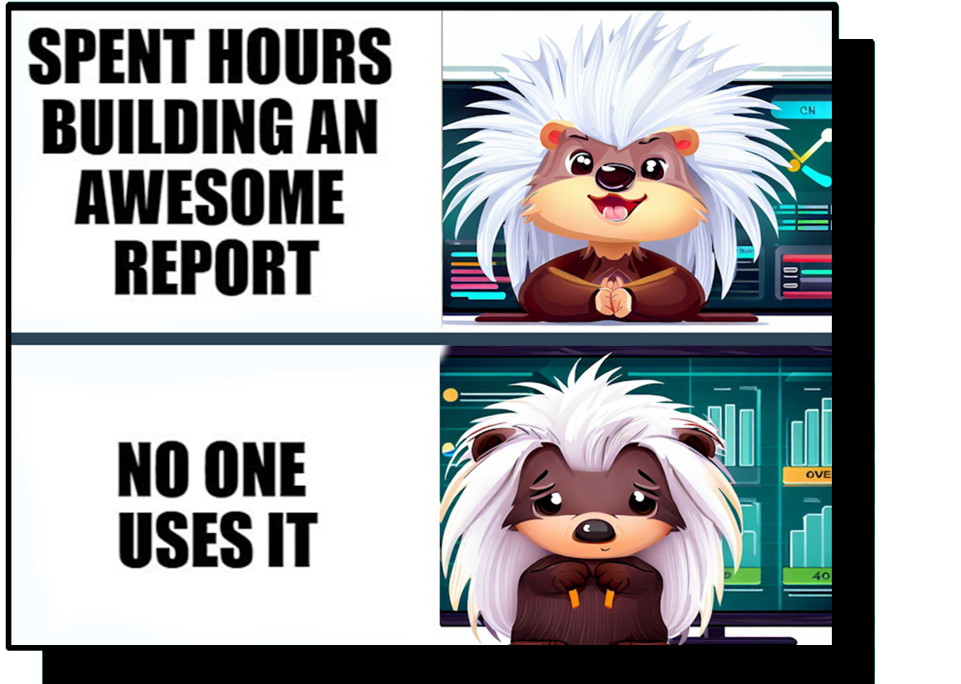

Slide 4


Valerie Junk PorcuBI
Data Analytics & Visualization
Data Storytelling
Process Improvement

Slide 5
Power BI – Design & Accessibility
Intuitive Design
Simple but informative
End-user oriented
Accessibility
Keyboard navigation & tab order
Screen reader & alt text
High Contrast
Focus Mode & Spotlight
Color ratio & Themes

Slide 6
Everybody knows?
Everybody
else
Everybode
Everybody
Coworkers
Industry
Friends
Notes:
You are not designing for yourself

Slide 7

Design for the audience
Who is the audience?
What is their level of experience?
How are they going to use the report?
How much detail do they need (and understand)?
What actions do they want to take?
Notes:
You are not designing for yourself

Slide 8
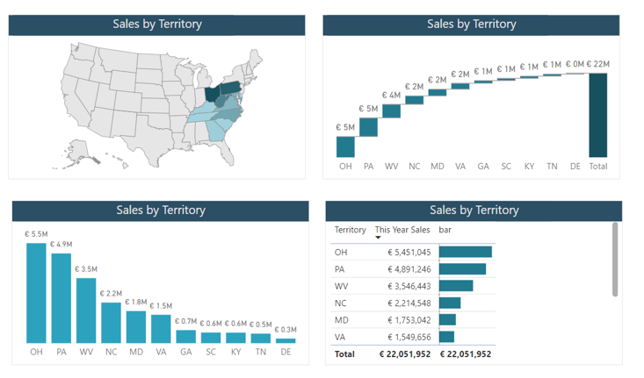
Visual = Goal + enduser
Goal (actions to take) & end-user determine the visual.
Same data can be visualized in different ways.
Notes:
Map, Waterfall chart, bar chart, matrix,

Slide 9
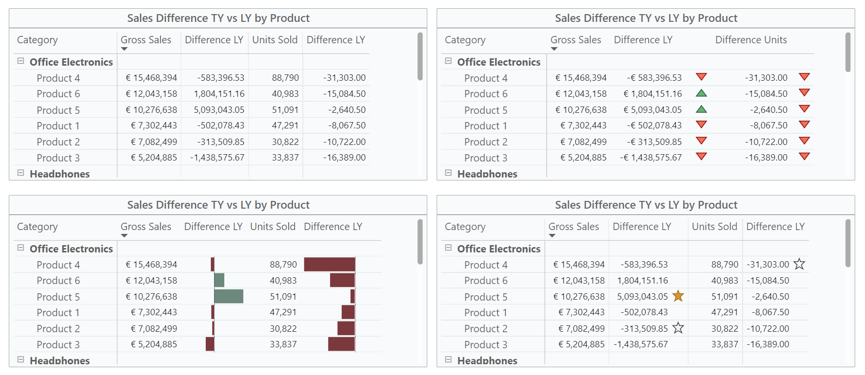
Small changes – huge effect

Slide 10
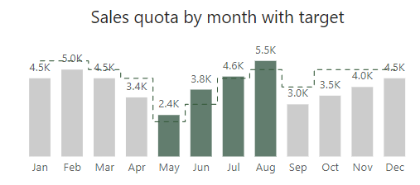
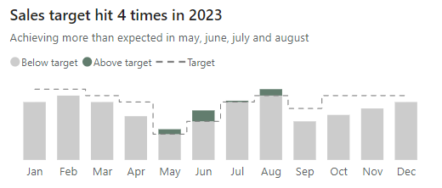
Adding Context
Title
Legend
Color Coding
Notes:
Don’t leave people guessing
Provide context
Provide first insights
Guide the end-user
End-users don’t need to analyze data to see results

Slide 11
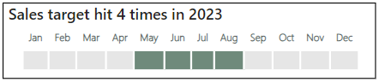
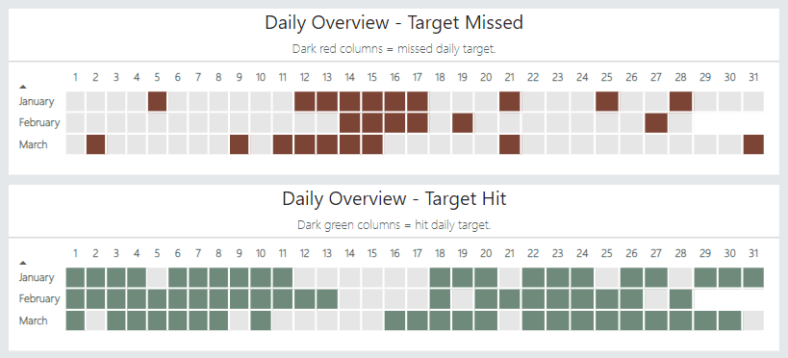
Simplify

Slide 12
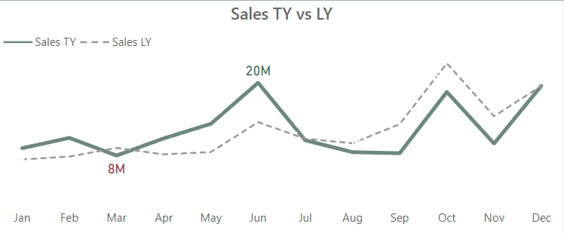
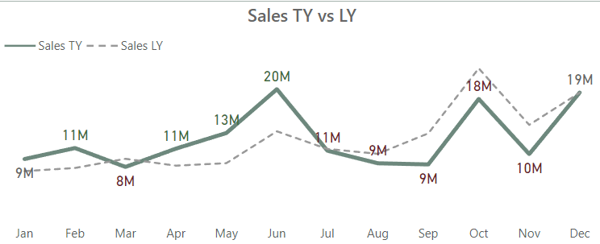
Declutter and/or Enrich
Which information is really relevant?
How much guidance is needed?

Slide 13
Power BI – Design & Accessibility
Intuitive Design
Simple but informative
End-user oriented
Accessibility
Keyboard navigation & tab order
Screen reader & alt text
High Contrast
Focus Mode & Spotlight
Color ratio & check & Themes

Slide 14
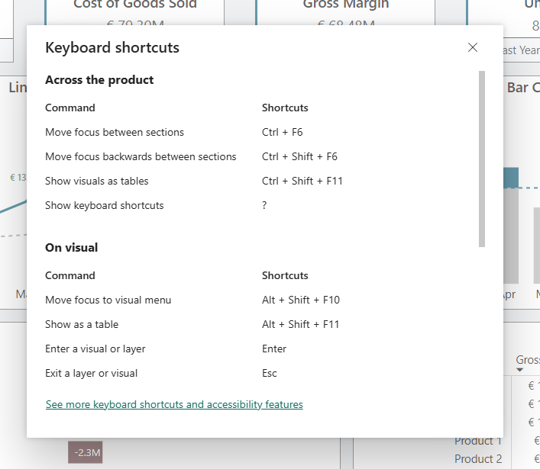
Keyboard navigation
All elements can be navigated using keyboard shortcuts
Shift + ? = Overview shortcuts
Ctrl + F6 = Move between sections
Enter = Enter/Exit a visual
Ctrl + Space = Multi-select data points
Ctrl Shift C = Unselect all filter selections.
Ctrl + Shift + F11 = Show visuals as tables
https://learn.microsoft.com/en-us/power-bi/create-reports/desktop-accessibility-keyboard-shortcuts

Slide 15
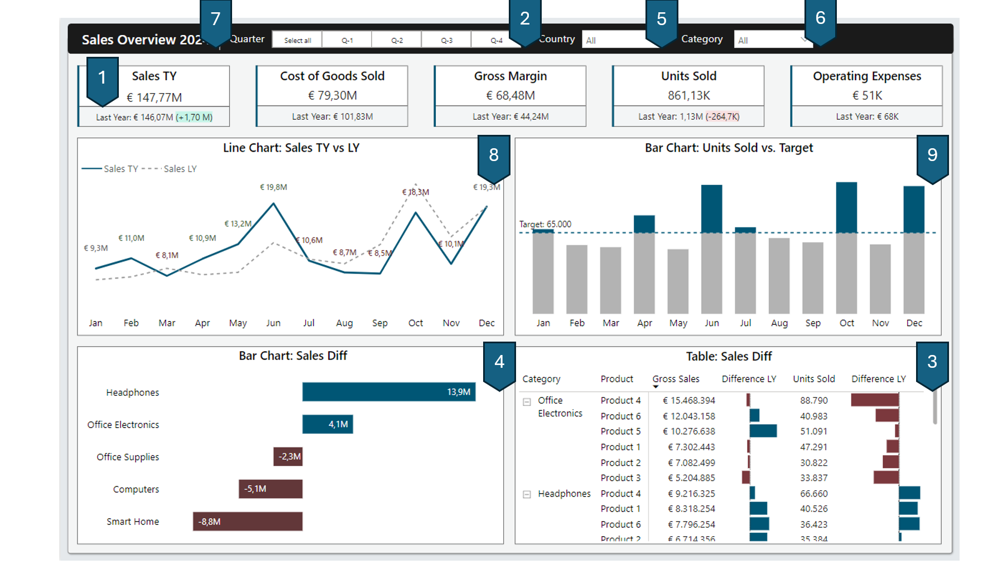
Keyboard navigation?

Slide 16
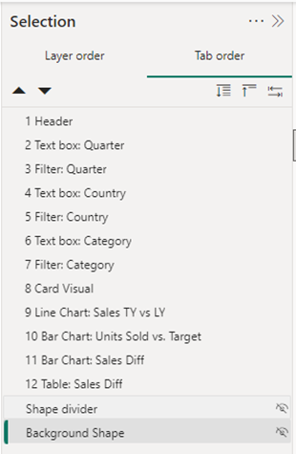
Changing the tab order
View –> Selection –> Tab order
Drag and Drop
Importance of naming elements.
Hide everything you don’t want to use.

Slide 17
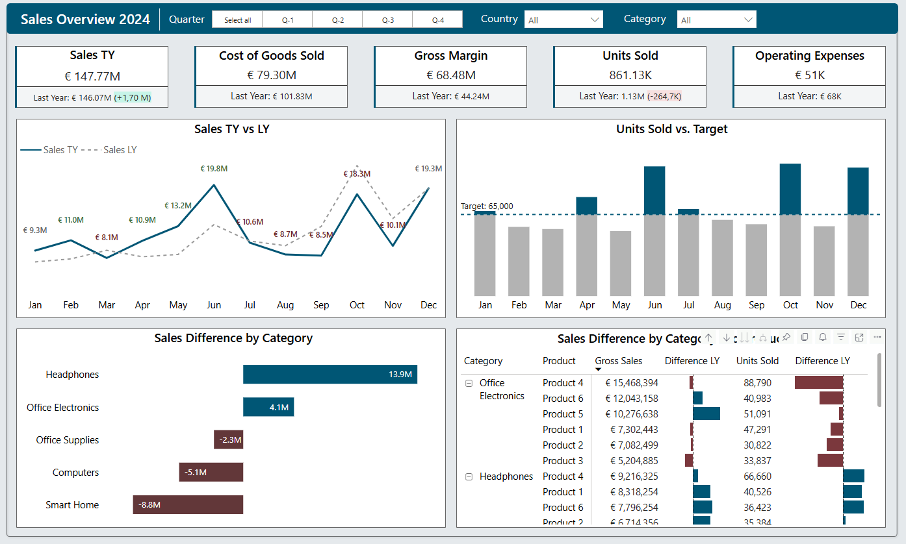
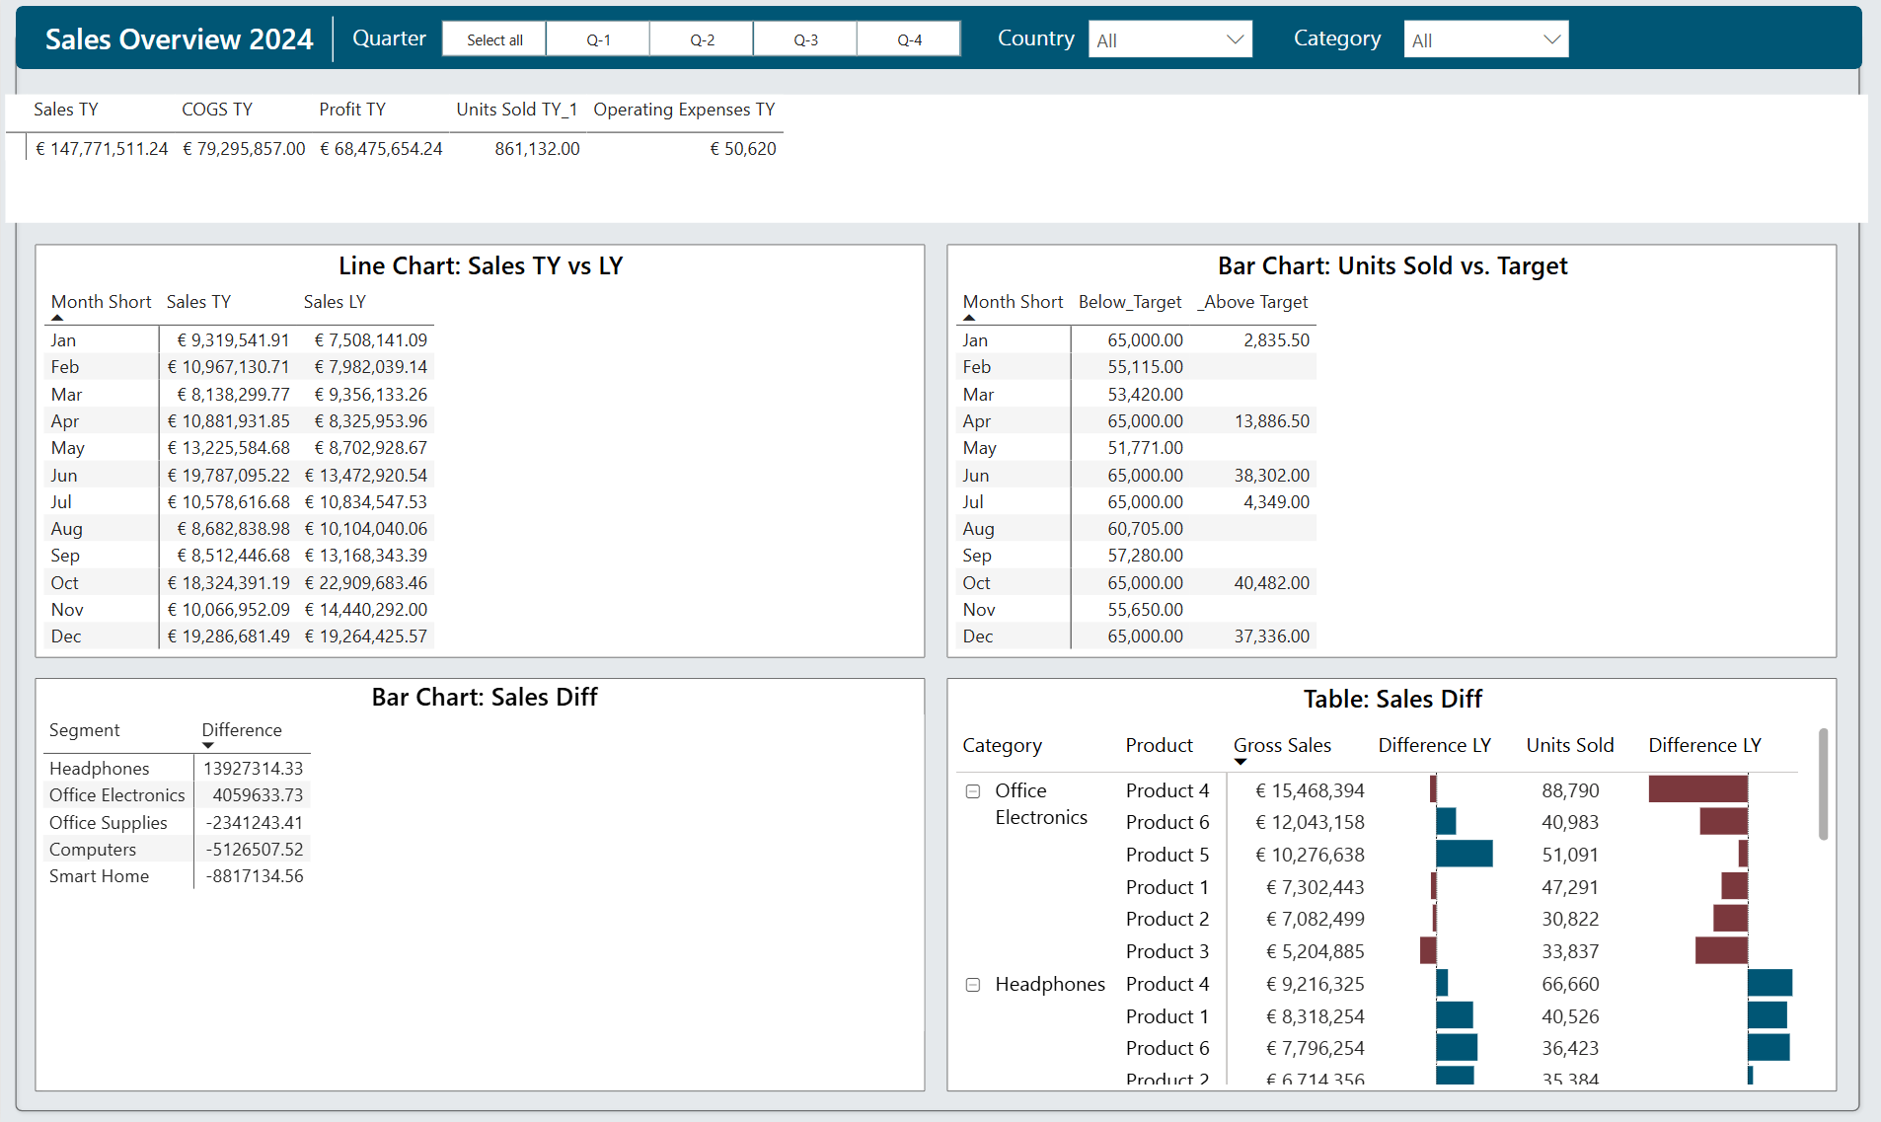
Ctrl + Shift + F11

Slide 18
Screen reader Compatibility
When a report consumer navigates to a visual, the screen reader will read out:
the title
visual type
any alt text (if set)

Slide 19

Screen reader Compatibility
“img”
Shape with text
“2 items grouping, text box”
Shape and text box grouped
“Sales Data”
Text box

Slide 20
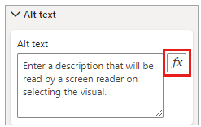
Alt text
Alternative Text
Read by screen readers.
Meaningful information about the element.
Max 250 characters.
Use DAX to make it dynamic.

Slide 21
Alt text example
“img”
Shape with text
“Sales Data img”
Shape with text & alt text “Sales Data”

Slide 22
High-contrast Color View
Power BI has standard high-contrast support for reports!
You can choose from 4 options.
High-contrast #1
High-contrast #2
High-contrast Black
High-contrast White

Slide 23
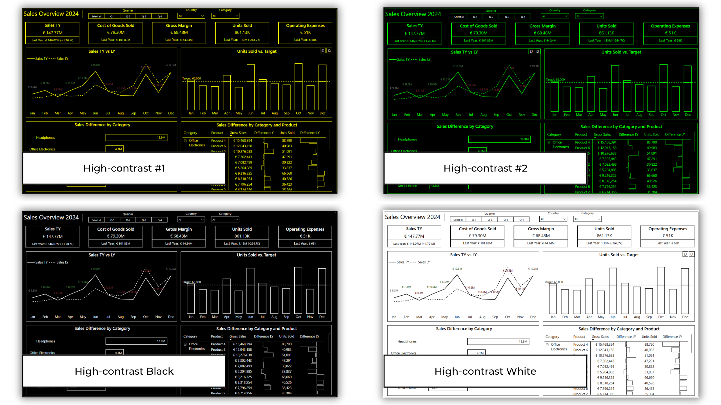
High-contrast Color View

Slide 24
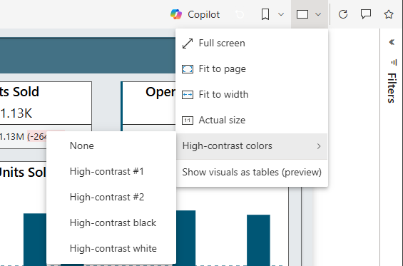
High-contrast Color View
You can set the view in Power BI (online).
"View" button -> "High-contrast colors."

Slide 25
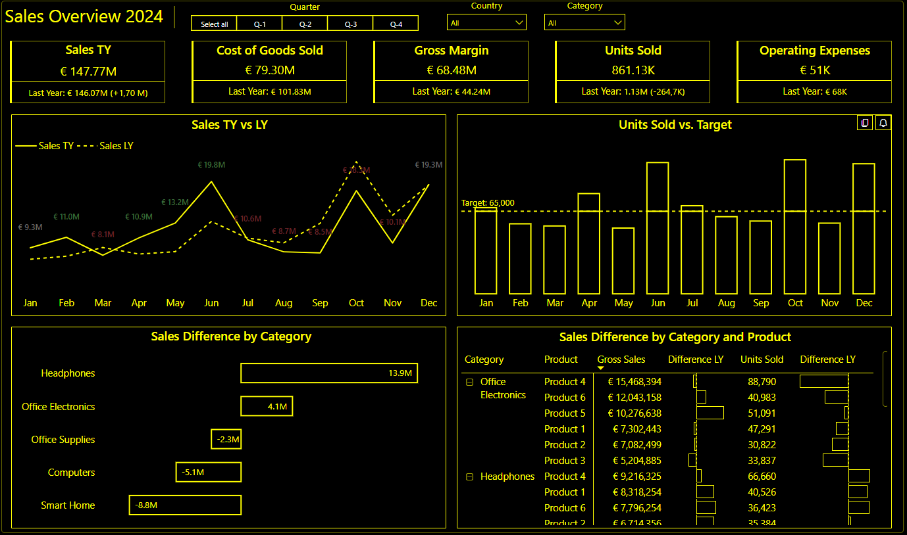
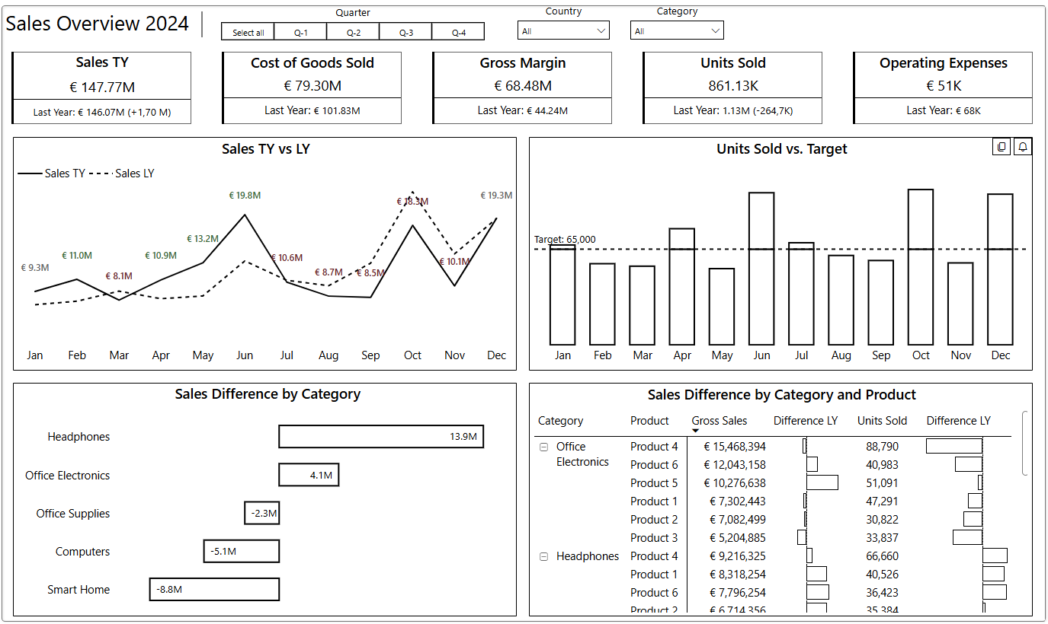
High-contrast Color View
Word of warning: Conditional formatting is not changed!

Slide 26
Spotlight Focus mode
Can be done
by the user!

Slide 27
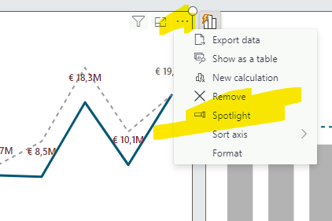
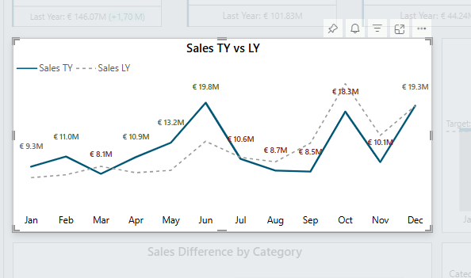
Spotlight
Focus on one visual in the report

Slide 28
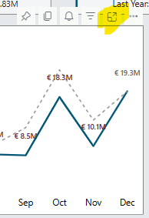
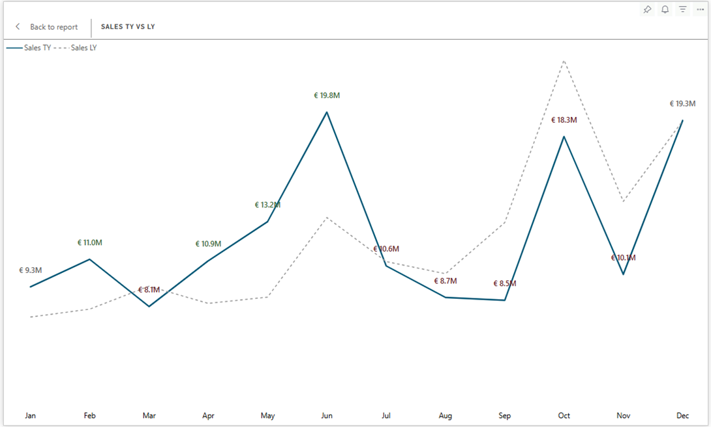
Focus Mode
New window to view the visual

Slide 29
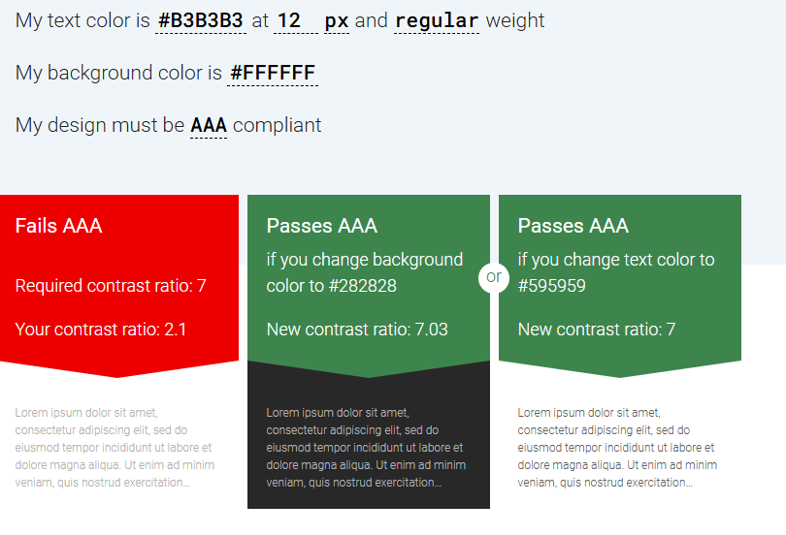
Colorblind friendly colors
Background & text contrast ratio at least 4.5:1
The lighter color (background)
is 4.5 times brighter than
the darker color (text).
The text is distinguishable
from the background
https://accessible-colors.com/

Slide 30
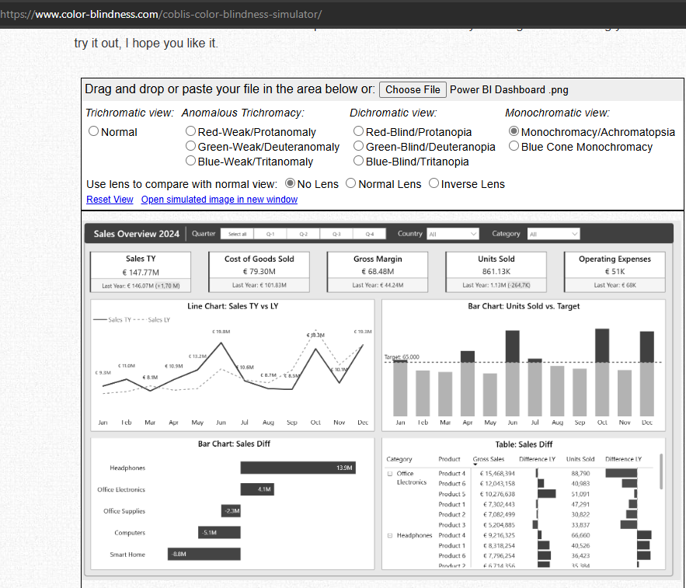
Color check
www.color-blindness.com
Squint test
Turn down the brightness of screen
Do you still see the most important information?
Check with the end-user

Slide 31

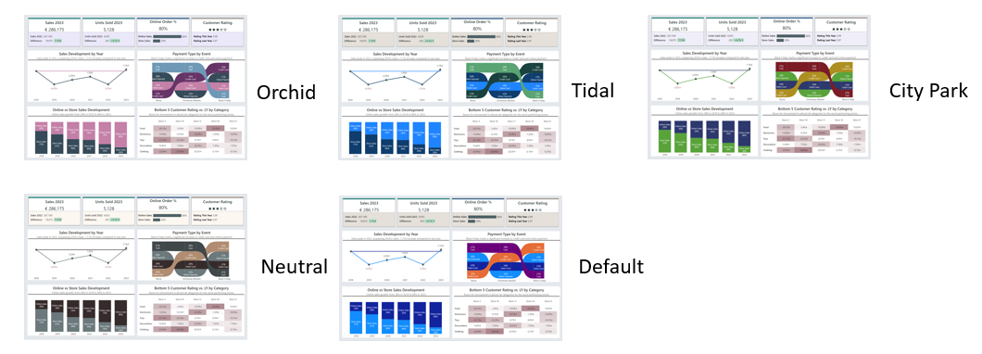
Accessibility Themes
*this only works when you have not set the colors manually (or with conditional formatting)

Slide 32
Takeaway
Design for the audience & tell a story
Goal + Enduser = Visual
Provide context & meaning
Accessibility is not a buzzword
Do not just use color to convey information but also text & icons.
Add alternative text
Check the tab order.

Slide 33




Contact
info@porcubi.nl
https://www.linkedin.com/in/valeriejunk/
@porcubi
https://www.youtube.com/@PorcuBI

Slide 34


